Slide 1




ITM University Gwalior Minor Project CSD0603
“Music Recommendation using Facial Emotion Detection”
Presented by
Shruti Agnihotri
BETN1CS20110

Slide 2

INDEX
Content | Page No.
Introduction | 3
ProblemStatement | 5
Dataset Details | 6
Methodology | 7
Expected Outcomes | 10
Conclusion | 11
Future Work | 12
References | 13

Slide 3
INTRODUCTION
Music plays an important role in our life. It’s not just a source of entertainment in our life. It gives us relief and reduces our stress thus music also imparts a therapeutic approach. It helps to improve our mental health.
The main objective of our music recommendation system is to provide suggestions to the users that fit the user’s preferences. The analysis of the facial expression/user emotion may lead to understanding the current emotional or mental state of the user.
More than 60 percent of the users believe that at a certain point of time the number of songs present in their songs library is so large that they are unable to figure out the song which they have to play. By developing a recommendation system, it could assist a user to make a decision regarding which music one should listen to helping the user to reduce his/her stress levels

Slide 4
INTRODUCTION
This project recognizes the facial expressions of user and play songs according to emotion. Facial expressions are best way of expressing mood of a person.The facial expressions are captured using a webcam and face detection is done by using Haar cascade classifier
The captured image is input to CNN which learn features and these features are analyzed to determine the current emotion of user then the music will be played according to the emotion. In this project, five emotions are considered for classification which includes happy, sad, anger, surprise, frustration, fear, neutral.
This project consists of 4 modules-face detection, feature extraction, emotion detection, songs classification. Face detection is done by Haar cascade classifier, feature extraction and emotion detection are done by CNN. Finally, the songs are played according to the emotion recognized.

Slide 5
PROBLEM STATEMENT
“Develop a Music recommendation system which will generate a musical playlist for the user based on his/her mood, by capturing his/her facial expressions.”

Slide 6
DATASET DETAILS
Fer-2013 dataset was prepared by Pierre-Luc Carrier and Aaron Courville, as part of an ongoing research project.They have graciously provided the workshop organizers with a preliminary version of their dataset to use for this contest.
The data consists of 48x48 pixel grayscale images of faces.The faces have been automatically registered so that the face is more or less centered and occupies about the same amount of space in each image.The task is to categorize each face based on the emotion shown in the facial expression in to one of seven categories (0=Angry, 1=Disgust, 2=Fear, 3=Happy, 4=Sad, 5=Surprise, 6=Neutral).
The train.csv contains two columns, "emotion" and "pixels".The "emotion" column contains a numeric code ranging from 0 to 6, inclusive, for the emotion that is present in the image.The "pixels" column contains a string surrounded in quotes for each image.The contents of this string a space-separated pixel values in row major order. test.csv contains only the "pixels" column and your task is to predict the emotion column.
This dataset consists of 35,887 grayscale images.The training set consists of 28,709 examples.The public test set consists of 3,589 examples.

Slide 7
METHODOLOGY
Input Dataset
Training the CNN Model
Capture the face of user using webcam
Facial Feature Extraction
Generating the Playlist
Music Classifier
Detecting the emotion

Slide 8
METHODOLOGY
e
Music recommendation based on facial emotion recognition contains four modules.
•Real-Time Capture: In this module, the system is to capture the face of the user correctly.
•Face Recognition: Here it will take the user's face as input. The convolutional neural network is programmed to evaluate the features of the user image.
•Emotion Detection: In this section extraction of the features of the user image is done to detect the emotion and depending on the user's emotions, the system will generate captions. •Music Recommendation: Song is suggested by the recommendation module to the user by mapping their emotions to the mood type of the song

Slide 9
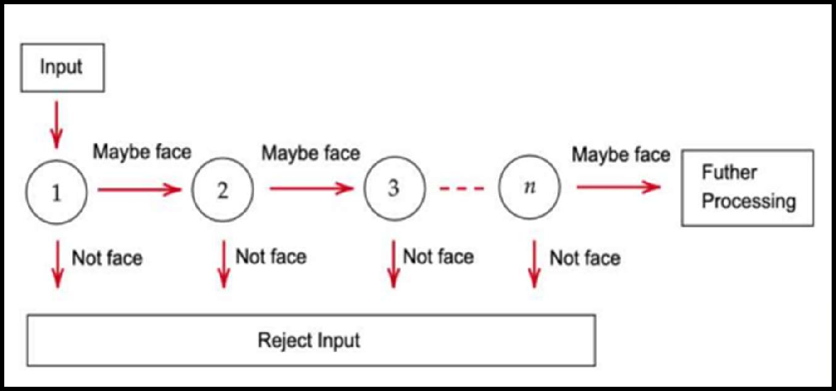
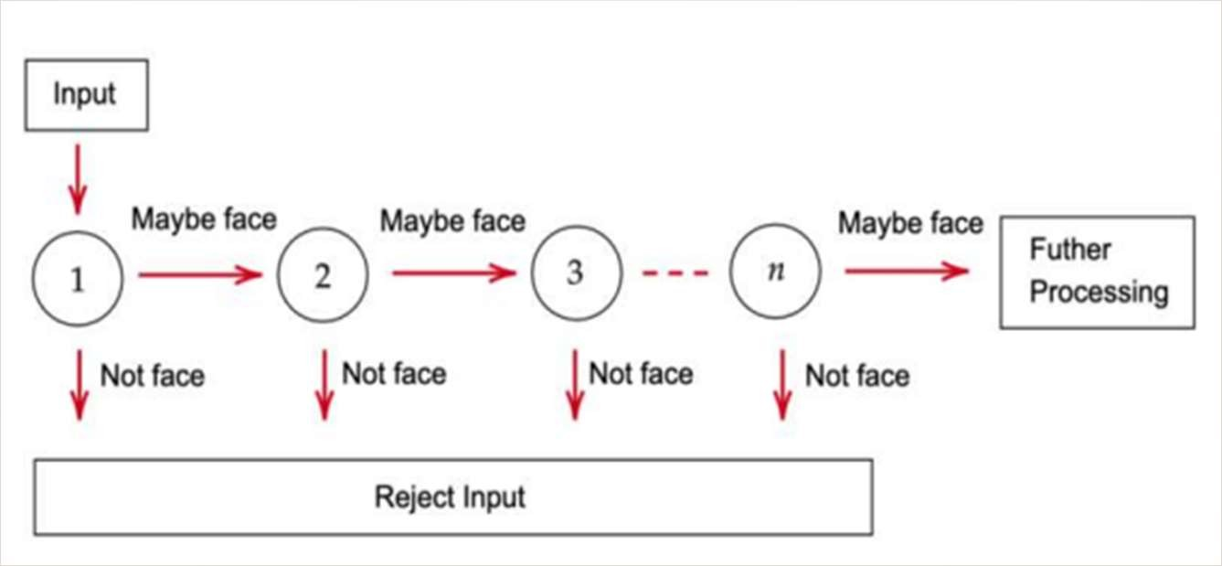
Haar Cascade Classifier :
It is a feature based object detection algorithm to detect objects from images. It does not require extensive computation and can run in real time .
Cascade Classifier :
It is a feature based object detection algorithm to detect objects from images. It does not require extensive computiation and can work in real time .
Fig. : Cascade Classifier

Slide 10
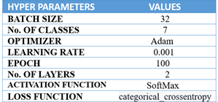
Results
In this proposed model we have not stick on one image for testing, While the code will run it will
take around 10 images in a short time(1-2 sec) and for all those images it will compute result and
according to the average value of that it will give result.Once the system identifies the emotional
state of the user, it proceeds to create a playlist through the Spotify API that is customized to the
detected emotion.

Slide 11

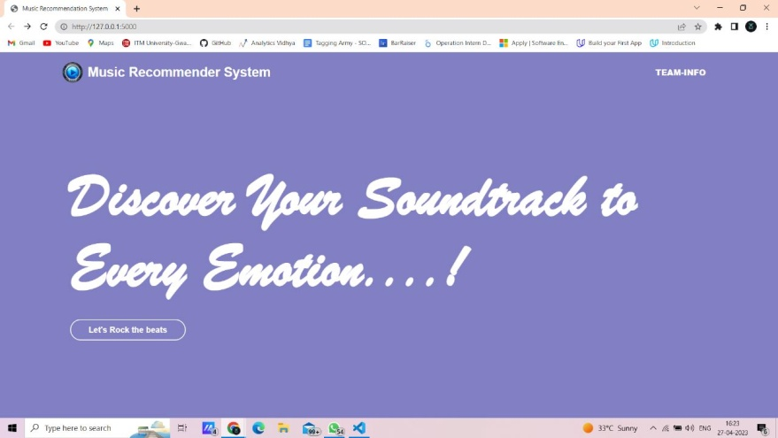
Front-Page View of the Application.
After the face is detected the emotion captured is listed

Slide 12

Spotify plays the music based on mood

Slide 13
Expected Outcomes:
The expected outcomes of a music recommender based on facial emotions include:
1.Improved user experience: A music recommender based on facial emotions can provide a more
engaging and personalized music listening experience for users. By recommending music that
matches their emotional state, the user is more likely to enjoy and engage with the music.
2.Enhanced emotional well-being: Music can have a significant impact on a person's emotional well-
being. By recommending music that is emotionally relevant to the user's current state, a music
recommender based on facial emotions can improve their mood, reduce stress, and promote
relaxation.
3.Increased music discovery: A music recommender based on facial emotions can also help users
discover new music that they may not have found otherwise. By analyzing the user's emotional state,
the recommender can recommend music that matches their current mood and preferences, and
expose them to new artists and genres.

Slide 14
CONCLUSION
A thorough review of the literature tells that there are many approaches to implement Music recommendation system using facial expressions.
Implementation of this project will help the user to automatically generate musical playlist using his facial expressions, saving his time and manual labour.
In this project, we are generating the playlist according to the emotion of the user, we developed a program for predicting the emotion of the user using Convolution neural networks and for generating the playlist we have used Spotify API.

Slide 15
FUTURE WORK
To improve accuracy for sad and disgust emotions.
To create a web or an android application.
To tackle constraints like web camera resolution, lighting conditions, and other such issues that hinder the emotion recognition.
To observe more human emotions and incorporate them into our project.
Integration with other technologies.
Integration of other biometric data.

Slide 16
REFERENCES
R. S. Deshmukh, V. Jagtap and S. Paygude, "Facial emotion recognition system through machine learning approach," 2017 International Conference on Intelligent Computing and Control Systems (ICICCS), 2017, pp. 272-277.
Athavle, M., Mudale, D., Shrivastav, U. and Gupta, M., 2021. Music Recommendation Based on Face Emotion Recognition. Journal of Informatics Electrical and Electronics Engineering (JIEEE), 2(2), pp.1-11.
Rashma, T.V., Kannur, K. and Cheemeni, K., Smart Music Player Based on Emotion Recognition from Facial Expression.
James, R., Sigafoos, J., Green, V.A. et al. Music Therapy for Individuals with Autism Spectrum Disorder: a Systematic Review. Rev J Autism Dev Disord 2, 39–54 (2015).
Florence, S.M. and Uma, M., 2020, August. Emotional detection and music recommendation system based on user facial expression. In IOP Conference Series: Materials Science and Engineering (Vol. 912, No. 6, p. 062007). IOP Publishing.
Agrahari, P., Tanwar, A.S., Das, B. and Kunekar, P., 2020. Musical Therapy using Facial Expressions.
EMOTION BASED MUSIC RECOMMENDATION SYSTEM M. Keerthana, M. Shruthi, S. Aravind Kumar
Sarda, Pranav & Halasawade, Sushmita & Padmawar, Anuja & Aghav, Jagannath. (2019). Emousic: Emotion and Activity-Based Music Player Using Machine Learning. 10.1007/978-981- 13-6861-5_16.
Emotion based Music Player Shital Rewanwar , Siddhika Pawar , Swati Bade , Sujata Oak
Li Y, Li X, Lou Z, Chen C. Long Short-Term Memory-Based Music Analysis System for Music Therapy. Front Psychol. 2022;13:928048. Published 2022 Jun 14. doi:10.3389/fpsyg.2022.928048
Pandeya YR, Bhattarai B, Lee J. Deep-Learning-Based Multimodal Emotion Classification for Music Videos. Sensors. 2021; 21(14):4927. https://doi.org/10.3390/s21144927

Slide 17
THANK YOU

